Slide 1
Meet Minder
Michael Mark
William D. Bodeis
Irina Gorlik
Samuel A. Grossmeyer
Joseph G. Maes

Slide 2
Meet Minder​
The Meet Minder application is intended to be a schedule assistant to provide the originator and the participants visibility on the scheduled event, focusing on the physical location of the event and notifications to allow the participants to be better prepared​

Slide 3
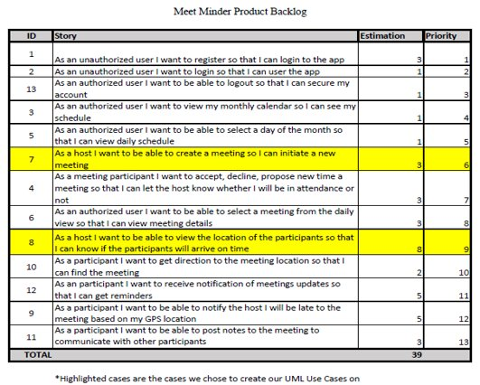
User Stories

Slide 4
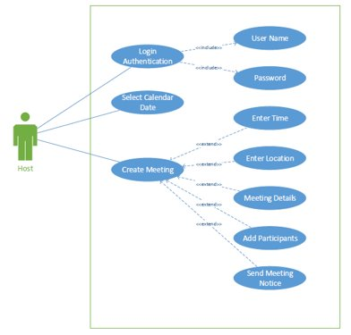
UML Diagram UC7​

Slide 5
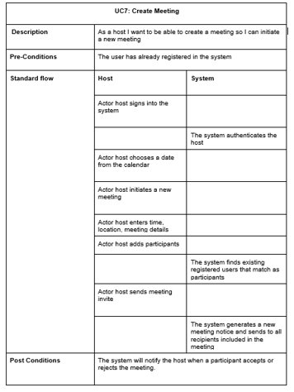
UC7

Slide 6
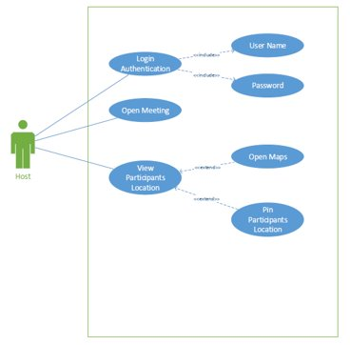
UML Diagram UC8​

Slide 7
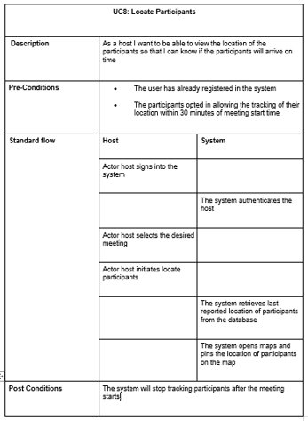
UC8

Slide 8
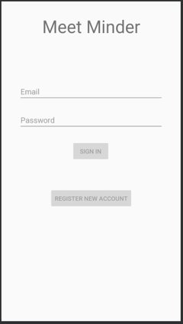
Sign in Screen

Slide 9
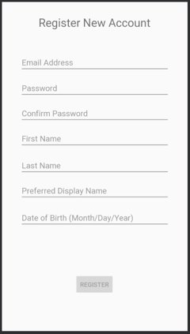
Registration

Slide 10
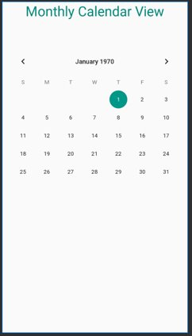
Monthly Calendar

Slide 11
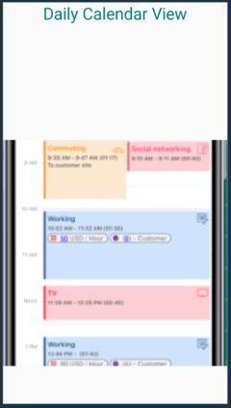
Daily Calendar and Meetings

Slide 12
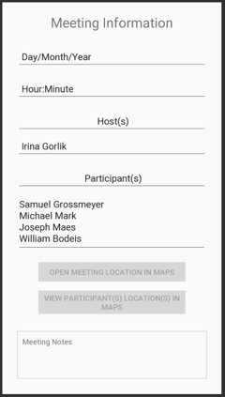
Host’s Meeting View

Slide 13
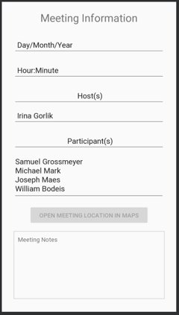
Participant's Meeting View

Slide 14
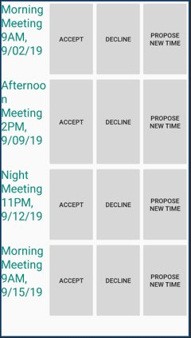
List of Meetings

Slide 15
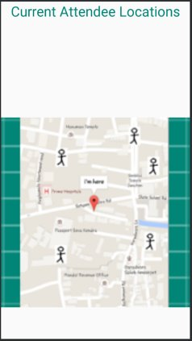
Host’s Map View

Slide 16
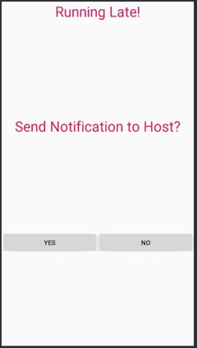
Late Notification

Slide 17
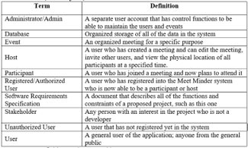
SRS Document Part 1: Introduction​
5 revisions versions – 0.1, 0.2, 1.0, 1.1, and 1.2​
In the Software Specification Requirements Part 1, we introduced the project and its purpose and came up with a list of terms as well. ​

Slide 18
SRS Document Part 2: Overall Description
In Part 2, the overall project was described​
Product perspective – for group collaboration and meetings for mid-twenties to mid-forties​
UI Screens listed​
Parts 1 and 2 are for the customers​
Product Functions​
​User registration​
Login​
Switch views​
Create/Edit events

Slide 19
SRS Document Part 3: Detailed Requirements​
Categorized by class​
Most classes pertain to GUI screen specifications​
Defined what GUI’s are involved​
Defined specific requirements on each​
Users and Admins also included​
Classes included in detailed requirements include:​
LoginDisplay​
RegisterDisplay​
MonthlyCalendar​
DailyCalendar​
MeetingDisplay​
LocationDisplay​
User​
Admin​

